Slide 1
CYCLISTIC BIKE-SHARE VISUALIZATION
Communicating findings effectively to Cyclistic’s executive team
Presenter: Kayode Adeniran
Date: July 12, 2025
Notes:
To communicate findings effectively to Cyclistic’s executive team, multiple visualizations were created

Slide 2
CYCLISTIC BIKE-SHARE VISUALIZATION
Power BI was used to create professional visualizations that compare the riding patterns of casual riders and annual members. A bar chart was designed to compare average ride duration, demonstrating that casual riders take longer trips than members. A clustered column chart shows ridership volume by day of the week, indicating that members primarily ride on weekdays, whereas casual riders peak on weekends. Lastly, a time-of-day line chart shows that members ride most frequently during morning and evening commute hours, whereas casual riders ride more consistently during midday hours. Together, these visuals clearly communicate behavioral differences and support marketing strategies focused on converting casual riders into annual members.

Slide 3
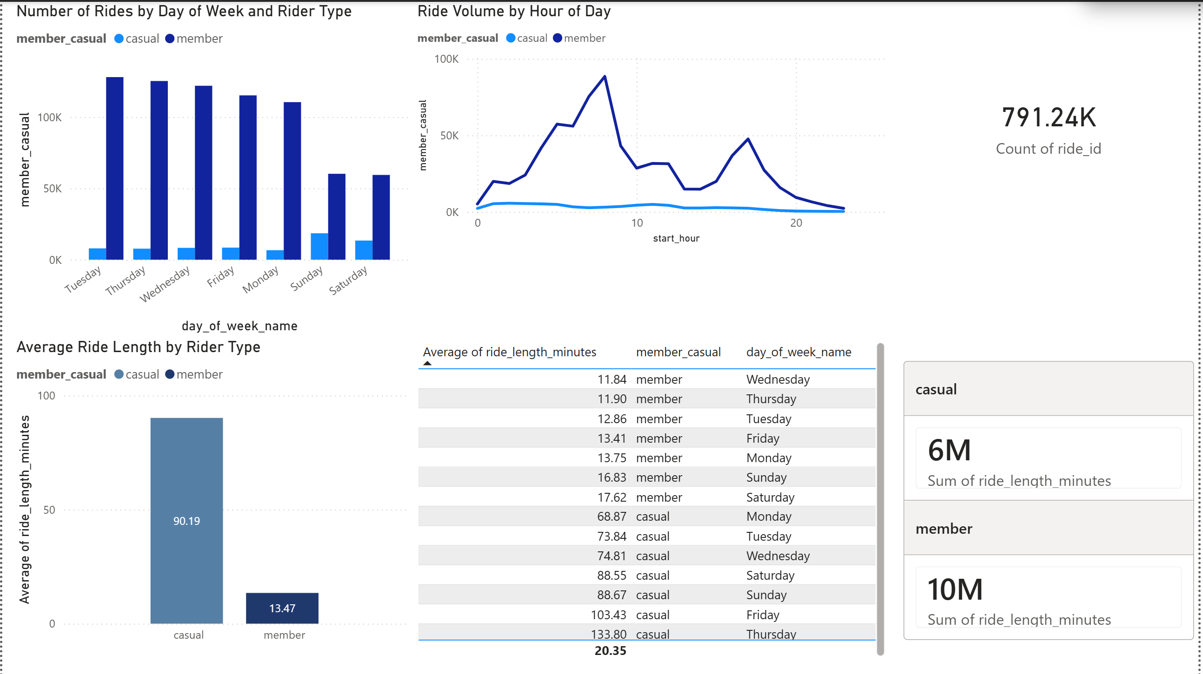
Dashboard
Notes:
The Commerce clause in Article I, Section 8, Clause 3, of the U.S. Constitution, grants Congress the power “to regulate Commerce with foreign Nations, and among the Several States, and with the Indian Tribes”
Examples of government regulation of business include:
Environmental Protection Agency (EPA) that restrict the emission of industrial wastes into the environment, and protect public health.
Federal Trade Commission (FTC) enforces consumer protection laws against false advertising and unfair trade practices.
Occupational Safety and Health Administration (OSHA) sets workplace safety standards to reduce injuries and liabilities.
Businesses must stay informed to avoid legal trouble.

Slide 4
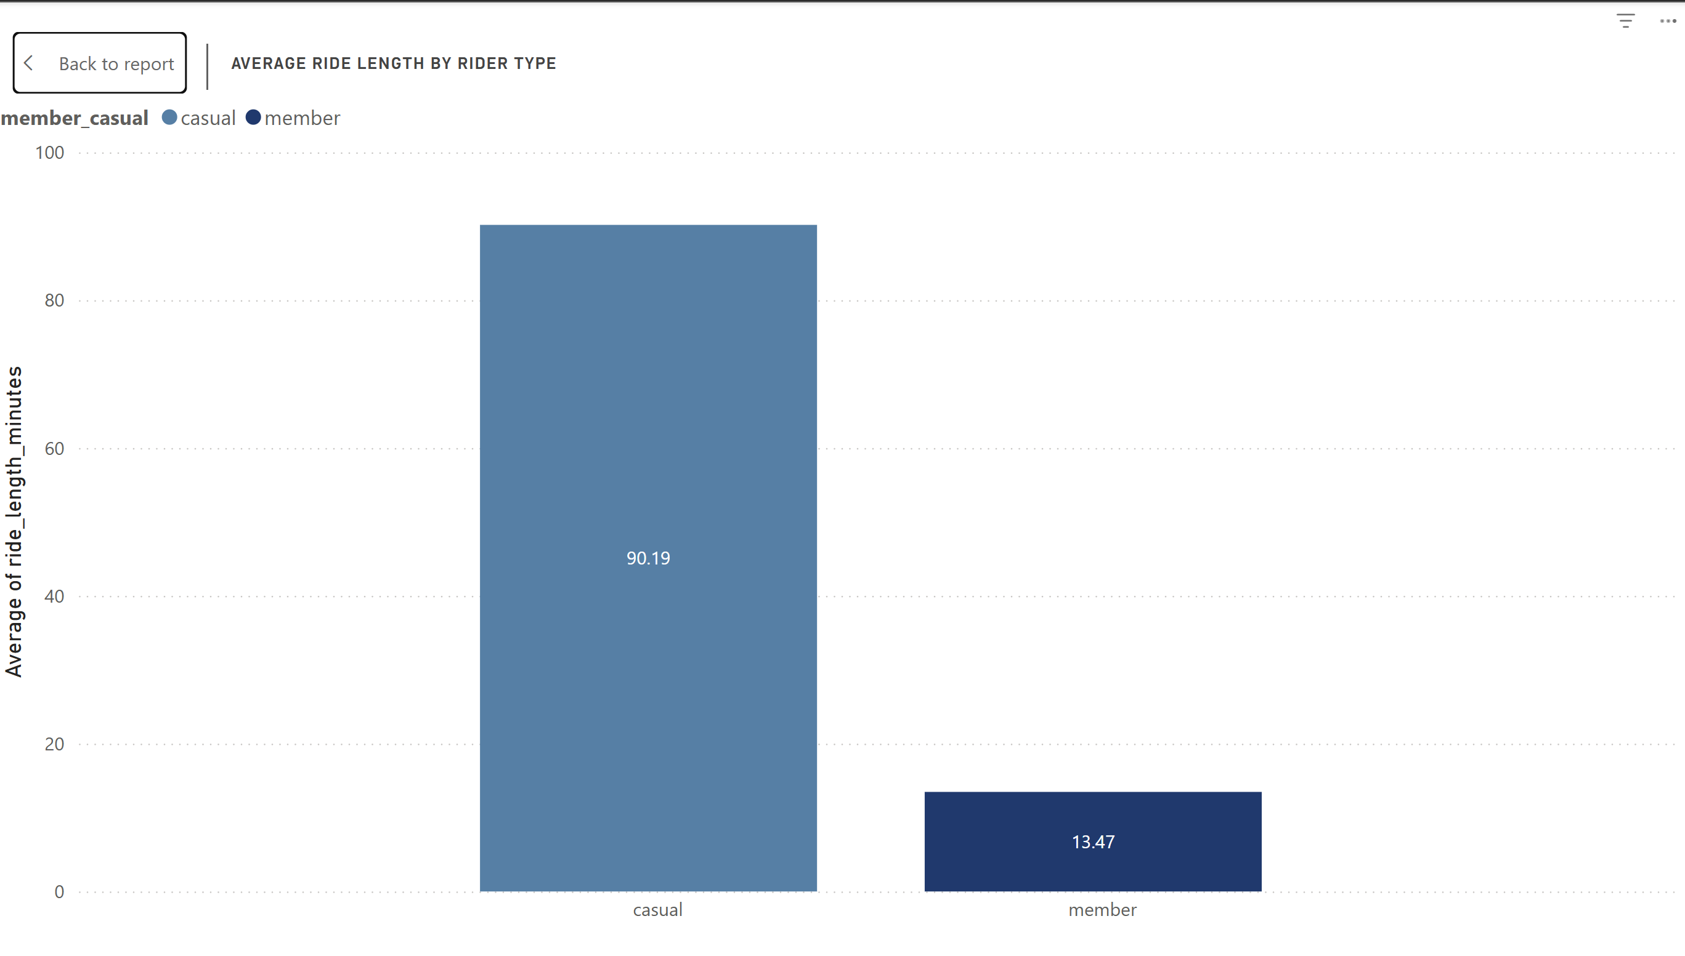
BAR CHART: Average Ride Length by Rider Type
Notes:
A bar chart comparing average ride length by rider type clearly illustrated that casual riders take longer trips than members. This visualization made the difference immediately apparent and supported the narrative around leisure versus utility usage

Slide 5
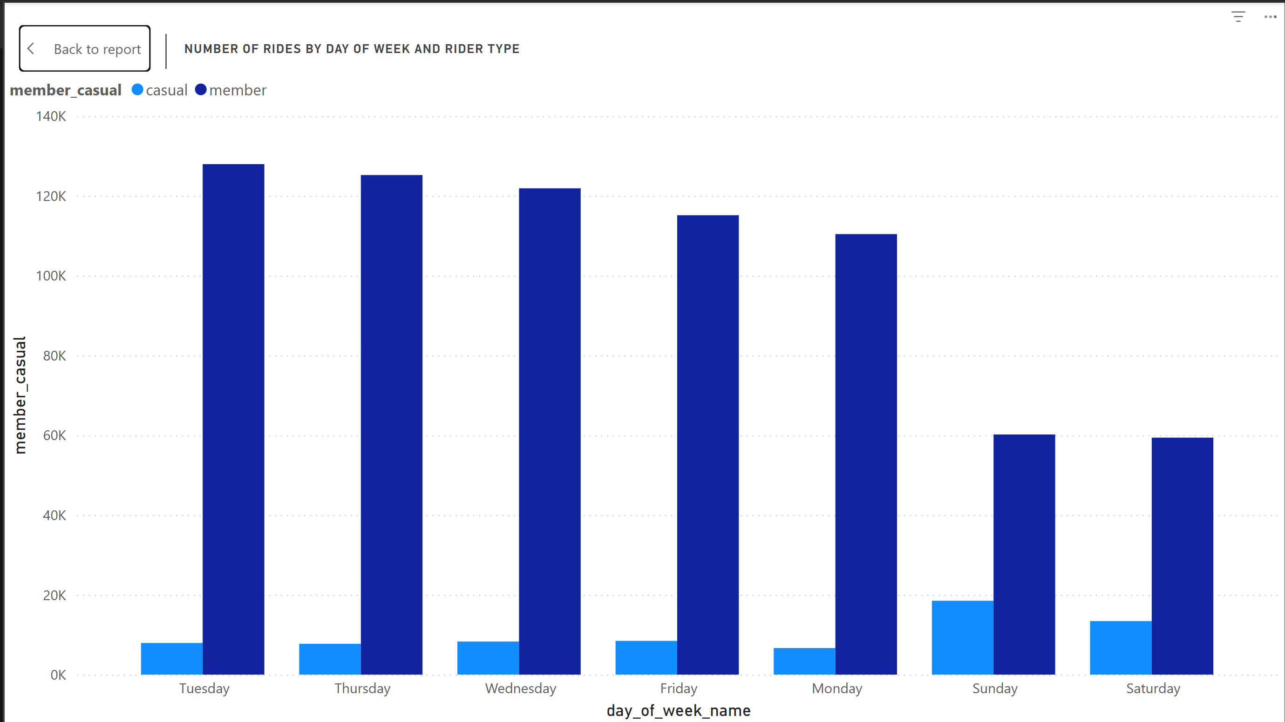
CLUSTERED BAR CHART: Number of Rides by Day of Week and Rider Type
Notes:
A clustered bar chart showing the number of rides by day of week and rider type, highlighted the weekday dominance of members and the weekend concentration of casual riders. This chart reinforced the idea that commuting behavior is a key differentiator between the two groups.

Slide 6
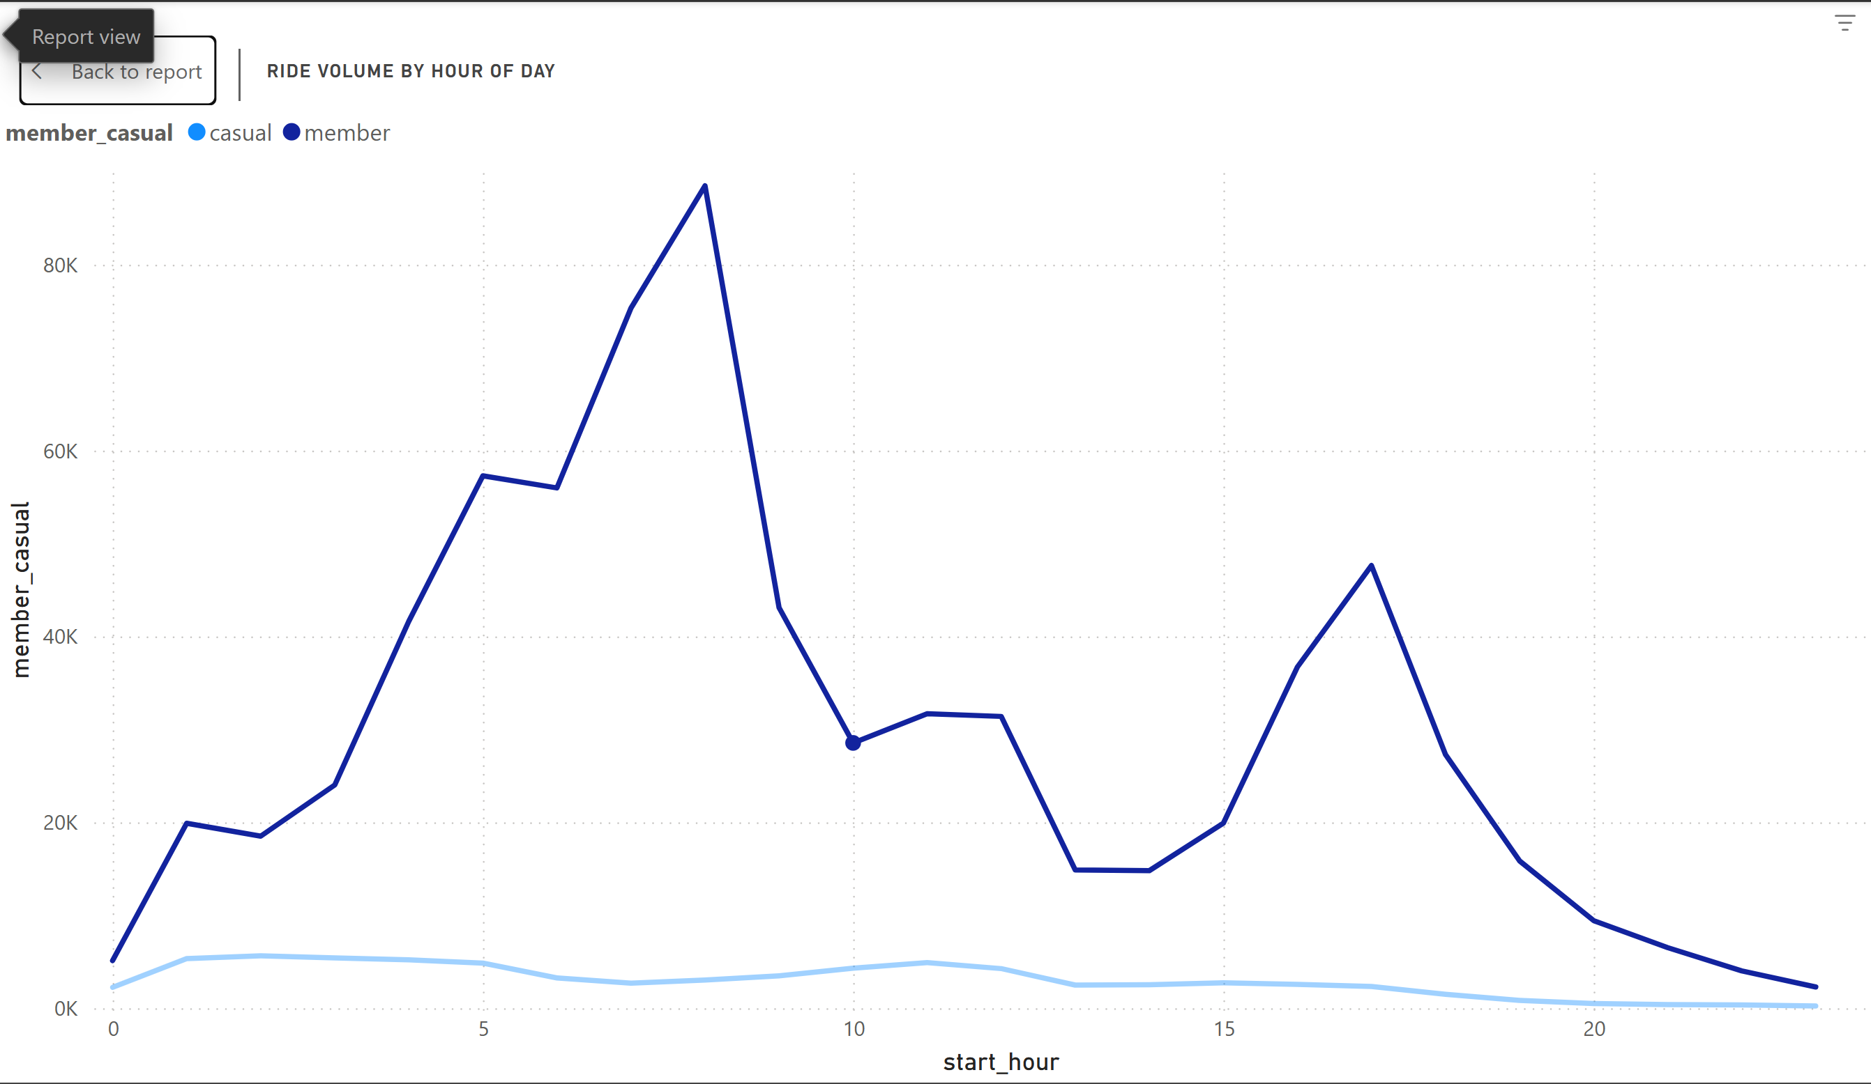
LINE CHART: Ride Volume by Hour of Day
Notes:
A line chart of ride volume by hour of day showed commute-time peaks for members and mid-day peaks for casual riders.

